Slide 1

QUAID.E.AWAM UNIVERSITY OF ENGINEERING SCIENCE AND TECHNOLOGY ,NAWABSHAH
Ontology-Augmented Transformer Architecture For Advanced Sentiment Analysis in Sindhi
Anisha Azam Ali
24-MS(I.T)-04
Supervisor: Prof Dr. Akhter Hussain Jalbani
Presentation For the Initial Seminar
Department : Information Technology
1

Slide 2
Content
Introduction
Applications
Literature Review
Problem Statement
Aims and Objectives
Proposed Framework
Tools and Techniques
Expected Outcomes
Timeline
References
Department : Information Technology
2

Slide 3
Introduction
The goal of artificial intelligence (AI), a revolutionary area of computer science, is to mimic human intelligence in machines. Machine learning, neural networks, computer vision, robotics, and natural language processing (NLP) are among the fundamental fields of artificial intelligence.
Sentiment analysis, or the act of recognizing and classifying feelings or sentiments represented in text, is the main focus of this proposal, which is centered on natural language processing.
Because there are few linguistic tools and annotated datasets available, sentiment analysis in low-resource languages like Sindhi is still mostly unexplored.
In order to enhance sentiment classification in Sindhi text, this proposal presents the concept of linking BERT (Bidirectional Encoder Representations from Transformers) with an ontology-driven framework.
Department : Information Technology
5

Slide 4
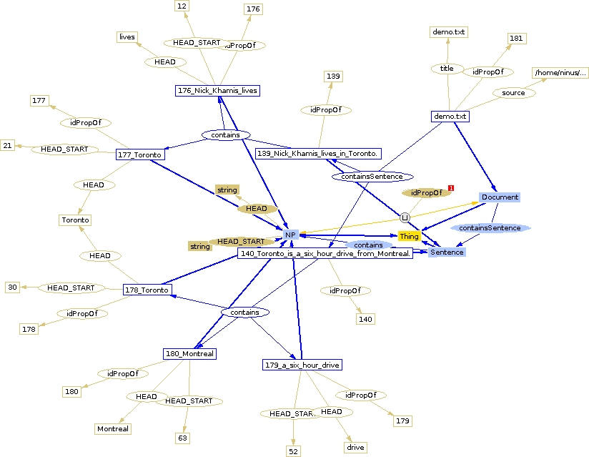
What is Ontology?
Ontology in computer science and artificial intelligence refers to a formal, structured representation of knowledge — it defines concepts, their properties, and the relationships among them within a specific domain.

Slide 5
Ontology in NLP and Sentiment Analysis:
Semantic Understanding: Ontologies allow machines to understand words beyond surface-level meaning, considering context, polarity, and related terms.
Disambiguation: Helps distinguish between multiple meanings of a word using concept hierarchies and relations (e.g., "bank" as a financial institution vs. riverbank).
Sentiment Assignment: Words or concepts can be assigned positive, negative, or neutral sentiment scores, improving accuracy over keyword-based or purely statistical models.
Low-Resource Language Support: In languages like Sindhi, where pre-trained resources and datasets are limited, ontologies provide handcrafted semantic knowledge to fill the gap.

Slide 6
Applications
1 Social Media Monitoring – Analyze public sentiment on platforms like Twitter and Facebook in the Sindhi language.
2 News and Media Analytics – Classify emotional tone in Sindhi news for media bias detection and audience insight.
3 E-Governance and Feedback Analysis– Understand citizen feedback written in Sindhi to improve government services
4 Business Intelligence– Evaluate Sindhi customer opinions to refine marketing and product strategies.
5 Academic and Linguistic Research– Support future studies on low-resource languages through datasets and ontology
6 Healthcare Opinion Mining– Extract sentiment from Sindhi health-related reviews to improve patient care.
7 Cultural and Political Studies – Track regional sociopolitical trends through sentiment analysis of public texts.

Slide 7
Literature Review
Ref: No | Paper Name | Author name | Dataset | Model | Accuracy
[1] | Bilingual Ontology Dictionary in Sindhi & English | Rattar et al. (2018) | Not specified | Manual Ontology-based Translation | 90%–100% accuracy
[2] | Ontology-based Arabic Sentiment Analysis | Khabour et al. (2022) | Hotel dataset | Domain Semantic Ontology | 79.20% accuracy, 78.75% F1
Department : Information Technology
7

Slide 8
Ref: No | Paper Name | Author name | Dataset | Model | Accuracy
[3] | Emotion Ontology for Roman Urdu | Nargis & Jamil (2016) | Not specified | WordNet-Affect & Ontology | 85.40% recall, 92.87% precision
[4] | Arabic Hadith Ontology Survey | Muhammed et al. (2024) | Hadith Texts | Semantic Classification via Ontology | 94.5% F-measure
Department : Information Technology
8

Slide 9
Ref: No | Paper Name | Author name | Dataset | Model | Accuracy
[5] | Domain-Specific Urdu Annotation (Automobile) | Rajput (2014) | Web Ads (Automobile) | Ontology-based Annotation | 100% attribute accuracy
[6] | BERT for Sindhi News Sentiment | Barakzai et al. (2022) | Sindhi News | BERT (Multilingual) | 67.2% accuracy
Department : Information Technology
9

Slide 10
Ref: No | Paper Name | Author name | Dataset | Model | Accuracy
[7] | Urdu Sentiment Analysis with mBERT | Khan et al. (2022) | Not specified | Multilingual BERT | 81.49% F1 score
[8] | DEMLOnto – Multilingual Emotion Ontology | Tao & Liu (2017) | Multilingual texts | OWL2 Ontology-based | Focus on semantic context (no exact metric)

Slide 11
Ref: No | Paper Name | Author name | Dataset | Model | Accuracy
[9] | DL + Ontology Features for Reviews | Zhao & Lee (2024) | Restaurant Reviews | Deep Learning + Ontology | Enhanced fine-grained accuracy (no exact value)
[10] | OMASA – Multi-Aspect Sentiment Analysis | Sharma et al. (2024) | Hotel Reviews | Ontology-Driven Aspect Analysis | Notable improvement (no exact value)

Slide 12
Ref: No | Paper Name | Author name | Dataset | Model | Accuracy
[11] | Automotive Feature-based Sentiment | Chowdary et al. (2016) | Automotive domain | WSD + Domain Ontology + Polarity Rules | Performance improved (no exact metric
[12] | Creating and Evaluating Resources for Sentiment Analysis in the Low-resources Language:Sindhi | Ali et al. (2021) | Sindhi Tweets(News,sports,Finance) | SVM,RNN,CNN with Sindhi Subjective Lexicon | Not Specified:Lexicon-based approach evaluated

Slide 13
Ref: No | Paper Name | Author name | Dataset | Model | Accuracy
[13] | A systematic Review on Sentiment Analysis for Sindhi Text | Soomro et al. (2024) | Various Sindhi Text | Review of Preprocessing,Feature Extraction,Classification Methods | Comprehensive Analysis, no specific accuracy reported
[14] | Sentiment Analysis Based on Urdu Reviews Using Hybrid Deep Learning Methods | Singh et al. (2023) | Urdu Reviews | Hybrid Deep Learning Methods | Not Specified,Focus on Model development
[15] | Attention Based RU-BiLSTM Sentiment Analysis model for Roman Urdu | Chandio et al. (2022) | Roman Urdu Text | Attention Based RU-BiLSTM | Not specified,Model Architecture proposed

Slide 14
Ref: No | Paper Name | Author name | Dataset | Model | Accuracy
[16] | Roman Urdu Sentiment Analysis Using Transfer Learning | Li et al. (2022) | Roman Urdu Text | Transfer Learning Approach | Not specified, application of transfer learning.
[17] | Effective Lexicon-Based Approach for Urdu Sentiment Analysis | Rehman & Bajwa (2016) | Urdu Text | Lexicon-Based approach | Not specified, Lexicon development discussed.
[18] | A Review of Urdu Sentiment Analysis with Multilingual Perspective:A case of Urdu and Roman Urdu | Khan et al. (2022) | Urdu and Roman Urdu Text | Reviews of various approaches | Comprehensive review, no specific accuracy reported

Slide 15
Ref: No | Paper Name | Author name | Dataset | Model | Accuracy
[19] | Zero-shot Sentiment Analysis in Low-Resources Languages Using a Multilingual Sentiment Lexicon | Koto et al. (2024) | 34 Languages Including Low-Resources Ones | Multilingual Sentiment Lexicon with Pretraining | Demonstrated superior zero-shot performance
[20] | UniSent:Universal Adaptable Sentiment Lexica for 1000+Languages | Asgari et al.(2019) | 1000+languages | Sentiment Lexica via Parallel Bible Corpus | Comparable to manually created resources
[21] | A Multilingual Sentiment Lexicon for Low-resources languages Translation using LLMs and AI | Malinga et al.(2024) | Languages including ulu,Sepedi,Tshiluba | RF,SVM,BERT with Explainable AI | BERT achieved 99% accuracy and 98% precision

Slide 16
Ref: No | Paper Name | Author name | Dataset | Model | Accuracy
[22] | Building Lexicon-Based Sentiment Analysis Model for Low-Resources Language | Authors Not specified (2023) | Hausa Tweets | Lexicon Creation and Fine-Tunning | Achieved 98% accuracy
[23] | NaijaSenti:A Nigerian Twitter Sentiment Corpus for Mulitlingua Sentiment Analysis | Muhammad et al.(2022) | Nigerain Languages(Housa,Igbo,Yoruba) | Language-specific Models and Transfer Strategies | Not specified,dataset and models released
[24] | HausaNlP at SemEval-2023 Task 12:Laveraging African Low Resource TweetData for Sentiment Analysis | Salahudeen et al.(2023) | 14 African Languagues | Afro-xlmr-large,AfriBERTa-lArge,mBERT | Afr-xlmr-Large performed better in most languages

Slide 17
Ref: No | Paper Name | Author name | Dataset | Model | Accuracy
[25] | Sentiment Analysis for Low Resources Languages:A study on Informal Indonesian Tweets | Le et al.(2016) | Indonesian Tweets | LSTM without Normalizer | Achieved 73.2% accuracy

Slide 18
Literature Review(Summary)
Over the years, integrating ontologies and machine learning models has significantly enhanced sentiment analysis across multiple languages, including low-resource ones like Sindhi and Urdu. Rattar et al.[1] Created a bilingual Sindhi-English ontology that classified verbs and adjectives to represent semantic relationships, achieving up to 100% accuracy through manual translation. Similarly, Khabour et al.[2] proposed an Arabic ontology-based sentiment analysis method that achieved 79.20% accuracy, while Zulf and Jamil [3] built an emotion ontology for Roman Urdu using WordNet-Affect, reporting 92.87% precision. In the domain of religious texts, Muhammad et al.[4] emphasized semantic enrichment in Hadith classification using ontologies, attaining a 94.5% F1 score. Rajput [5] developed an ontology-based framework for Urdu web content annotation, achieving perfect accuracy on attributes like make and model in ads. Barakzai et al.[6] utilized BERT for Sindhi sentiment analysis, obtaining 67.2% accuracy, indicating a need to embed Sindhi vocabulary into models. Khan et al. [7] employed multilingual BERT (mBERT) for Urdu sentiment analysis and surpassed conventional models with an F1 score of 81.49%. Tao and Liu [8] introduced DEMLOnto, an ontology-based model handling multilingual emotional semantics. Zhao and Lee [9] combined ontology-derived features with deep learning for fine-grained sentiment analysis, while Sharma et al.[10] used domain ontologies in OMASA for multi-aspect sentiment classification. Chowdary and Yadav [11] improved polarity detection using word sense disambiguation in an ontology-driven sentiment framework. Furthering this, Ali et al. [12]

Slide 19
Literature Review(Summary)
Developed sentiment resources for Sindhi, while Soomro et al.[13] conducted a systematic review highlighting limitations in Sindhi NLP tools. Singh et al. [14] tested hybrid deep learning on Urdu reviews, and Chandio et al. \[15] proposed an attention-based RU-BiLSTM model for Roman Urdu. Li et al. [16] implemented transfer learning for Roman Urdu sentiment tasks. Rehman and Bajwa [17] used a lexicon-based model for Urdu with promising results. Khan et al. [18] reviewed Urdu and Roman Urdu sentiment research in a multilingual context. Koto et al. [19] proposed zero-shot sentiment models using multilingual sentiment lexicons, and Asgari et al. [20] built UniSent—sentiment lexica for 1,000+ languages. Malinga et al. [21] explored large language models for multilingual lexicon building in low-resource settings. Bello et al. [22] focused on lexicon-based sentiment analysis in underrepresented languages. Muhammad et al. [23] developed NaijaSenti, a multilingual sentiment dataset for African languages. Salahudeen et al. [24] adapted Hausa tweets for sentiment classification using African tweet corpora, and Le et al. [25] tackled sentiment analysis on informal Indonesian tweets to support low-resource languages. Collectively, these studies emphasize the vital role of ontologies, multilingual resources, and deep learning in bridging the gap for under-resourced languages like Sindhi, paving the way for context-aware, semantically enriched sentiment analysis systems.

Slide 20
Problem Statement
Languages like Sindhi pose unique challenges for sentiment analysis due to their complex semantic structures and limited annotated resources. Traditional transformer-based models such as BERT struggle to capture context-specific sentiment and deep semantic relationships in such low-resource languages. The lack of comprehensive ontologies and domain-specific features further hinders performance. Previous studies (Sharma et al., 2024; Zhao & Lee, 2024) show that combining syntactic and semantic knowledge with machine learning can improve accuracy. Therefore, this study proposes an ontology-enhanced sentiment analysis framework that integrates semantic features with BERT to enhance performance for Sindhi text.
Department : Information Technology
11

Slide 21
Aim and Objectives
Aim:
The goal is to create a sentiment analysis framework for Sindhi text by
combining a BERT-based model with ontology-based semantic enrichment.
Objectives:
1.To Construct a Labelled dataset of particular Sindhi sentences and associated
word-level sentiments.
2. To build a sentiment Ontology that captures domain-specific semantics of
Sindhi text.
3. To train and compare two Bert-based sentiment classifiers: one on traditional
dataset, and another using the ontology-enhanced datasets.
4. To evaluate and demonstrate improvements in model performance when
using structured semantic knowledge.
Department : Information Technology
15

Slide 22
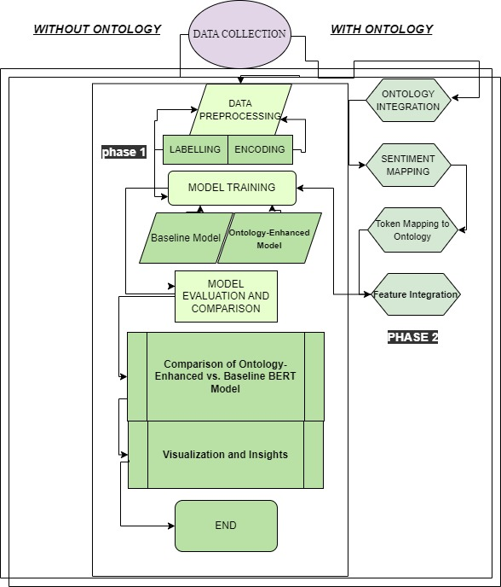
Proposed
Frame Work
Department : Information Technology
12

Slide 23
Proposed Frame Work
This research follows a two-phase methodology to evaluate the impact of ontology integration on sentiment analysis using a BERT-based model for the Sindhi language.
Phase 1: Without Ontology (Baseline Pipeline)Data Collection: A labeled Sindhi dataset with sentence-level and word-level sentiment annotations is collected.
Data Preprocessing: Text cleaning (removal of special characters, normalization) Tokenization, Encoding the data for BERT-compatible input.
Labeling and Encoding: Sentences and associated words are labeled with sentiment classes (positive, negative, neutral) and converted into numerical formats.
Model Training: A baseline BERT model is trained on the preprocessed Sindhi data without ontology support. The model learns from purely lexical and contextual cues.
Model Evaluation: Performance is measured using standard metrics (accuracy, F1-score) and serves as a benchmark for the ontology-enhanced model.
Department : Information Technology
13

Slide 24
Cont’d
Proposed FrameWork
Phase 2: With Ontology (Ontology-Enhanced Pipeline)
Ontology Integration: A domain-specific sentiment ontology is developed from the dataset, representing semantic relationships between words, sentiments, and domains.
2. Sentiment and Token Mapping:
Words and tokens in the dataset are linked to corresponding ontology concepts.
Sentiment values from the ontology are mapped back to tokens to enrich input features.
3. Feature Integration: Ontology-based sentiment and semantic information are injected into the input embeddings alongside BERT token embeddings.
4. Model Retraining and Comparison:
An ontology-enhanced version of the BERT model is trained using the enriched dataset.
This model is evaluated and compared against the baseline to determine performance gains.
Department : Information Technology
14

Slide 25
Proposed FrameWork Cont’d
Final Steps:
Comparison of Models: The performance of the ontology-enhanced model is compared against the baseline BERT using accuracy, F1-score, and confusion matrix.
Visualization and Insights: Graphs and tables are used to visualize improvements and analyze model behavior with and without ontology support.

Slide 26
Tools And Techniques
Tools:
• HuggingFaceTransformers for Bert Model Fine Tuning.
• Jupyter NoteBook for experimentation and training environment.
• Libraries: seaborn, matplotlib, sklearn, rdflib and transformers
• Editor of Ontology: Protégé
Techniques:
• Python is used as a core development language.
• Ontology Parsing: Using rdflib to extract sentiment annotations and semantic relationships.
• Tokenization: For Sindhi text, use the BERT tokenizer.
• Refinement of BERT for baseline and ontology-enhanced models in sentiment classification.
• Evaluation: Models are evaluated using confusion matrices, F1-score, recall, accuracy, and precision

Slide 27
Expected Outcomes:
A rich and Diverse Sindhi sentiment dataset.
A reusable OWL-based sentiment ontology.
Improved Sindhi text sentiment classification accuracy.
The efficiency of ontology-based semantic enrichment in natural language processing is
demonstrated.
Transformer models for other low-resource languages can be combined with ontologies using this reusable framework.

Slide 28
Timeline
Month | Task | Description
Month 1 | Literature review | Study existing work and define the research problem and objectives.
Month 2 | Dataset Collection and Preprocessing | Collect, clean and annotate the sindhi dataset for sentiment analysis.
Month 3 | Ontology development | Design and implement a semantic ontology for sentiment understanding.
Month 4 | Model implementation(BERT + Ontology) | Integrate BERT with the ontology-based system for sentiment anaylsis.
Month 5 | Testing and Evaluation | Evaluate system accuracy and performance using standard metrics.
Month 6 | Documentation and Final presentation | Prepare Thesis, Presentation slides and finalize delieverable.

Slide 29
References
[1] M. K. Rattar, M. A. Rattar, M. M. Rind, M. Hyder, and W. Khan, “Sindhi English Bilingual Parallel Ontological Dictionary,” Sindh University Research Journal (Science Series), doi: 10.26692/sujo/2018.06.0046.
[2] S. M. Khabour, Q. A. Al-Radaideh, and D. Mustafa, “A New Ontology-Based Method for Arabic Sentiment Analysis,” Big Data and Cognitive Computing, vol. 6, no. 2, Jun. 2022, doi: 10.3390/bdcc6020048.
[3] G. Zulf and N. Jamil, “Generating an emotion ontology for Roman Urdu text,” International Journal of Computational Linguistics Research, vol. 7, no. 3, pp. 83–91, 2016.
[4] M. A. Muhammed et al., “Arabic Ontology for Hadith Texts – A Survey,” The Egyptian Journal of Language Engineering, vol. 11, no. 1, pp. 1–14, 2024.
[5] Q. Rajput, “Ontology-based semantic annotation of Urdu language web documents,” Procedia Computer Science, vol. 35, pp. 662–670, 2014.
[6] F. Barakzai, S. Bhatti, and S. Saddar, “Sentiment Analysis of Sindhi News Articles using Deep Learning,” presented at the IEEE International Conference on Computer Science and Information Technology, 2022, doi: 10.1109/CSIT56902.2022.10000519.
.
Department : Information Technology
30

Slide 30
References
[7] L. Khan et al., “Multi-class sentiment analysis of Urdu text using multilingual BERT,” Scientific Reports, vol. 12, no. 1, pp. 5436–5446, 2022.
[8] W. Tao and T. Liu, “Building ontology for different emotional contexts and multilingual environment in opinion mining,” Intelligent Automation & Soft Computing, pp. 1–7, 2017.
[9] L. Zhao and S.-W. Lee, “Integrating Ontology-Based Approaches with Deep Learning Models for Fine-Grained Sentiment Analysis,” Computers, Materials & Continua, vol. 81, no. 1, pp. 1–14, 2024.
[10] S. Sharma, M. Saraswat, and A. K. Dubey, “Multi-aspect sentiment analysis using domain ontologies,” in Iberoamerican Knowledge Graphs and Semantic Web Conference, Springer, 2022.
[11] N. Yadav and C. R. Chowdary, “Feature-based sentiment analysis using a domain ontology,” presented at the 13th International Conference on Natural Language Processing, 2016.
[12] W. Ali, N. Ali, Y. Dai, J. Kumar, S. Tumrani, and Z. Xu, “Creating and Evaluating Resources for Sentiment Analysis in the Low-Resource Language: Sindhi,” in Proceedings of the Eleventh Workshop on Computational Approaches to Subjectivity, Sentiment and Social Media Analysis, 2021, pp. 188–194.
Department : Information Technology
31

Slide 31
References
[13] S. Soomro, A. Memon, and M. A. Memon, “A Systematic Review on Sentiment Analysis for Sindhi Text,” Baghdad Science Journal, vol. 18, no. 2, pp. 1–10, 2021.
[14] N. Singh and U. C. Jaiswal, “Sentiment Analysis Based on Urdu Reviews Using Hybrid Deep Learning Models,” Applied Computer Systems, vol. 28, no. 1, pp. 26–34, 2023
[15] B. A. Chandio, A. S. Imran, M. Bakhtyar, S. M. Daudpota, and J. Baber, “Attention-Based RU-BiLSTM Sentiment Analysis Model for Roman Urdu,” Applied Sciences, vol. 12, no. 7, p. 3641, 2022. [16] B. A. Chandio, A. S. Imran, M. Bakhtyar, S. M. Daudpota, and J. Baber, “Roman Urdu Sentiment Analysis Using Transfer Learning,” Applied Sciences, vol. 12, no. 20, p. 10344, 2022.
[17] Z. U. Rehman and I. Bajwa, “Lexicon-Based Sentiment Analysis for Urdu Language,” in 2016 International Conference on Innovative Computing Technology (INTECH), 2016
[18] L. Khan, A. Amjad, and N. Ashraf, “A Review of Urdu Sentiment Analysis with Multilingual Perspective: A Case of Urdu and Roman Urdu Language,” Computers, vol. 11, no. 1, p. 3, 2022
[19] F. Koto, T. Beck, Z. Talat, I. Gurevych, and T. Baldwin, “Zero-shot Sentiment Analysis in Low-Resource Languages Using a Multilingual Sentiment Lexicon,” in Proceedings of the 18th Conference of the European Chapter of the Association for Computational Linguistics (EACL 2024), 2024
[20] E. Asgari, F. Braune, B. Roth, C. Ringlstetter, and M. Mofrad, “UniSent: Universal Adaptable Sentiment Lexica for 1000+ Languages,” in Proceedings of the 12th Language Resources and Evaluation Conference (LREC 2020), 2020

Slide 32
References
[21] M. Malinga, M. W. Nkongolo, and M. M. Malinga, “A Multilingual Sentiment Lexicon for Low-Resource Language Translation and Sentiment Analysis,” arXiv preprint arXiv:2411.04316, 2024.
[22] B. S. Bello, S. S. Muhammad, and D. I. Adelani, “Lexicon-Based Sentiment Analysis for Underrepresented Languages,” Journal of African Languages and Linguistics, vol. 45, no. 2, pp. 123–140, 2023
[23] S. H. Muhammad et al., “NaijaSenti: A Nigerian Twitter Sentiment Corpus for Multilingual Sentiment Analysis,” arXiv preprint arXiv:2201.08277, 2022
[24] S. S. Abdullahi, D. I. Adelani, and B. S. Bello, “HausaNLP at SemEval 2023 Task 12: Leveraging African Low-Resource Tweet Data for Sentiment Analysis,” in Proceedings of the 17th International Workshop on Semantic Evaluation (SemEval-2023)
[25] T. A. Le, D. Moeljadi, Y. Miura, and T. Ohkuma, “Sentiment Analysis for Low Resource Languages: A Study on Informal Indonesian Tweets,” in Proceedings of the 12th Workshop on Asian Language Resources (ALR12), 2016

Slide 33



Department : Information Technology
32

